Slide 1
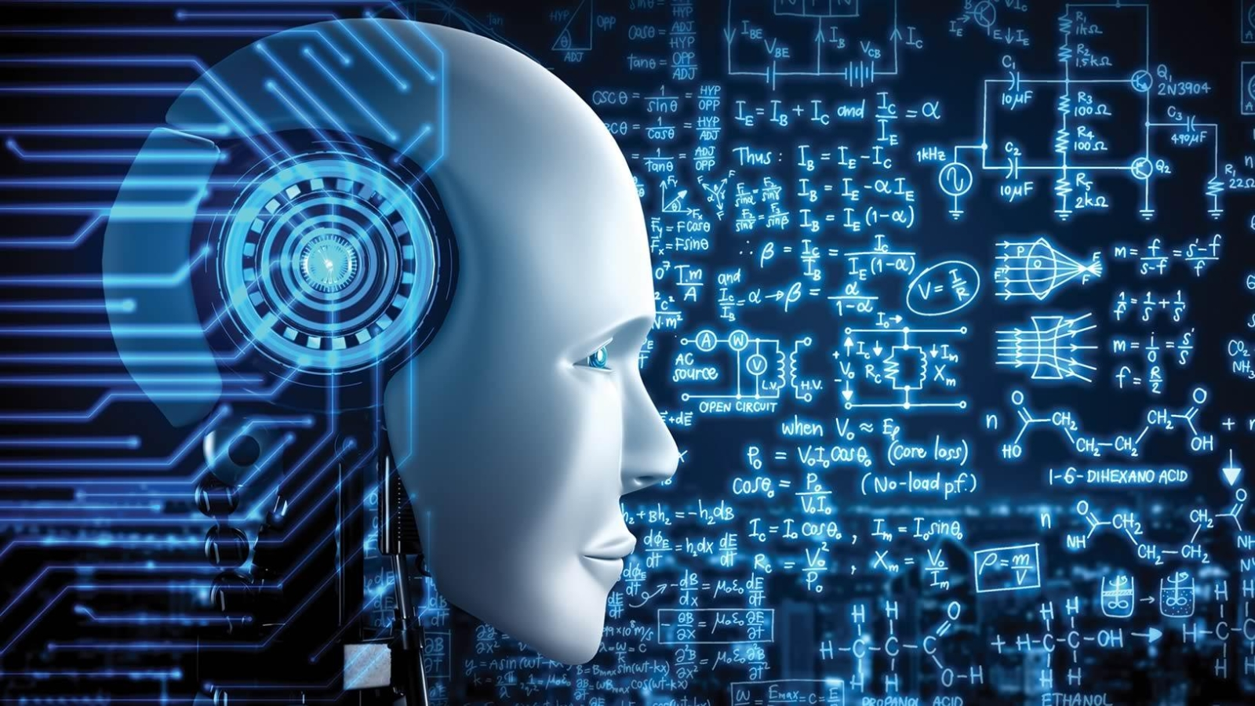
REINFORCEMENT LEARNING
Where agent learns to make optimal and sequential decisions by interacting with an environment
Presenter : Shebli Sadik
ID : 00725105101079

Slide 2

STATE
ACTION
Environment
AGENT
Possible moves the agent can take
The agent is the learner or decision-maker.
The current situation of the agent.
The system the agent interacts with.
2
1
3
4

Slide 3
KEY COMPONENTS
STATE
POLICY
AGENT
Environment
REWARD
ACTION
The agent is the learner or decision-maker.
The system the agent interacts with.
The current situation of the agent.
Strategy the agent uses to determine the next action
Possible moves the agent can take
Feedback signal guiding the agent’s learning
6
1
2
3
4
5

Slide 4
KEY COMPONENTS
ACTION
REWARD
POLICY
Possible moves the agent can take
Feedback signal guiding the agent’s learning
Strategy the agent uses to determine the next action
4
5
6

Slide 5
D
C
B
A
T
Y
P
E
S
Model Free
Policy Based
Value Based
Trial & Error
Agent estimates the future rewards
Agent directly learns the strategy
Agent learns directly from experience
Agent learns by exploring

Slide 6
B
C
D
A
A
Value Based
Policy Based
Model Free
Trial & Error
Value Based
Trial & Error
Agent learns by exploring
Agent estimates the future rewards
Agent directly learns the strategy
Agent learns directly from experience
Agent learns by exploring
Agent estimates the future rewards

Slide 7

A
P
P
L
I
C
A
T
I
O
N
4
2
1
3

Slide 8




Industrial Control
process optimization .
2
4
Robotics
motion control
navigation
1
3
Game
AlphaGo
Atari agents.
Recommendation Systems
personalized content.

Slide 9
CHALLENGES
1. Sample Inefficiency
Requires large amounts of data
Slow learning process
4. Training Instability
2. Sparse Rewards
Learning can be unpredictable
Results may fluctuate
Limited or infrequent feedback
Difficult for the agent to learn
3. Delayed Rewards
Rewards received after many actions
Hard to identify important actions

Slide 10

T
I
C
O
N
G
R
A
T
U
L
O
N
S
A
YOU HAVE LEARNED MACHINE LEARNING

